Slide 1
Relationship Between County Demographics and Prisoner Distributions
Group 1: Tim, Supanut, David, Ganesh, Rishabh

Slide 2
Background
Target Audience: Policymakers
Understanding the relationship between county demographics and prisoner distributions is crucial for designing effective policies and interventions aimed at reducing recidivism and addressing socioeconomic disparities in the criminal justice system.

Slide 3
Problem Statement & Objective
Despite existing research on both the distribution of individual prisoner and county-level demographic, here is limited understanding of how these two factors are related.
The objective of this project is to explore the relationship between county demographics and prisoner distributions to help us gain a deeper understanding of the underlying patterns and trends.

Slide 4
Hierarchical Approach
Lower Level: Distribution of Individual prisoners
Higher Level: Distribution of County

Slide 5
Considering Factors:
Race: Multinomial
– Asian and Pacific Islander/ Black/ Hispanic/ White
Sex: Binomial
– Male/ Female
Age: Normal
Marital Status: Multinomial
– Married/ Divorced/ Widowed/ Single
Employment status: Multinomial
–Employed/ Unemployed/ Retired/ Student/ Self Employed/ Laid Off
Education: Multinomial
–High school/ some school/ GED

Slide 6
Data Processing
Duplicate values have been eliminated based on the booking number column.
We have consolidated the categories in columns like Marital Status and Education through mapping.
A new column called 'county' has been created by associating cities with their corresponding counties.
No collinearity was observed among the columns.
The proportion of missing values in our significant features was less than 5%.

Slide 7
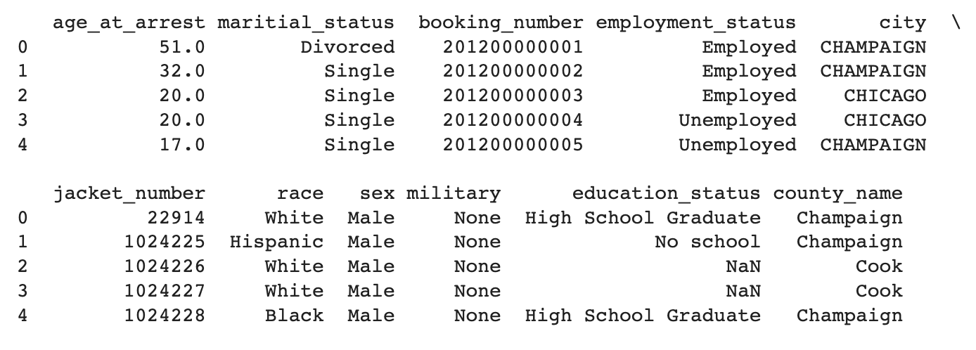
Sample Data After Processing

Slide 8
Binomial Variables

Slide 9
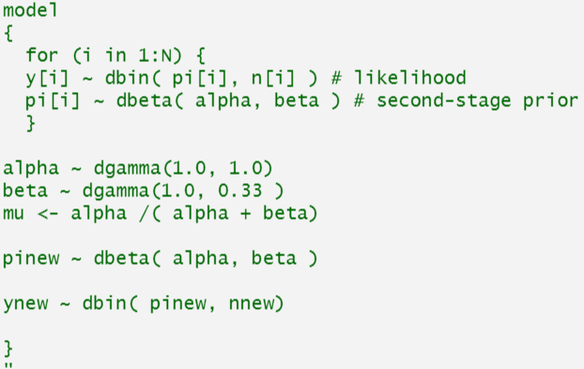
Binomial distributions
For categorical variables with 2 outcomes (example: gender)
The probability parameter p[i] is modeled as a beta distribution with hyperparameters “alpha “ and “beta
The hyper-parameters are modeled as Gamma(0.01, 0.01) distributions
For each county, 1 to 5 (Champaign, Cook, Vermilion, Douglas, Ford)
Gender: Male, Female
Employment status: Employed, Unemployed
Education status: High School graduate, No School

Slide 10
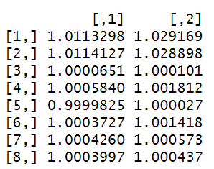
Binomial variable: Gender

Slide 11
Binomial variable: Gender
Posterior Distribution
Census Distribution
Relative difference
County | Male | Female
Champaign | 0.74 | 0.26
Cook | 0.84 | 0.16
Vermilion | 0.73 | 0.27
Douglas | 0.69 | 0.31
Ford | 0.76 | 0.24
New County | 0.75 | 0.25
Alpha | 37.14 | 11.92
County | Male | Female
Champaign | 0.5 | 0.5
Cook | 0.49 | 0.51
Vermilion | 0.51 | 0.49
Douglas | 0.5 | 0.5
Ford | 0.5 | 0.5
County | Male | Female
Champaign | 1.48 | 0.52
Cook | 1.71 | 0.31
Vermilion | 1.43 | 0.55
Douglas | 1.38 | 0.62
Ford | 1.52 | 0.48

Slide 12
Binomial variable: Gender
County | p-Value
Champaign | 0
Cook | 0
Vermilion | 0
Douglas | 0
Ford | 0

Slide 13
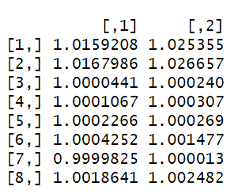
Binomial variable: Employment

Slide 14
Binomial variable: Employment
Posterior Distribution
Census Distribution
Relative difference
2017-2021
County | Employed | Unemployed
Champaign | 0.47 | 0.53
Cook | 0.38 | 0.62
Vermilion | 0.43 | 0.57
Douglas | 0.48 | 0.52
Ford | 0.46 | 0.54
New County | 0.45 | 0.55
Alpha | 37.74 | 46.51
County | Employed | Unemployed
Champaign | 0.61 | 0.39
Cook | 0.66 | 0.34
Vermilion | 0.55 | 0.45
Douglas | 0.64 | 0.36
Ford | 0.61 | 0.39
County | Employed | Unemployed
Champaign | 0.77 | 1.35
Cook | 0.57 | 1.82
Vermilion | 0.78 | 1.26
Douglas | 0.75 | 1.44
Ford | 0.75 | 1.38

Slide 15
Binomial variable: Employment
County | p-Value
Champaign | 0
Cook | 0
Vermilion | 0
Douglas | 0
Ford | 0

Slide 16
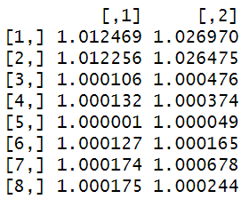
Binomial variable: Education

Slide 17
Binomial variable: Education
Posterior Distribution
Census Distribution
Relative difference
2017-2021
County | High School | No School
Champaign | 0.64 | 0.36
Cook | 0.80 | 0.20
Vermilion | 0.72 | 0.28
Douglas | 0.72 | 0.28
Ford | 0.72 | 0.28
New County | 0.72 | 0.28
Alpha | 33.00 | 12.74
County | High School | No School
Champaign | 0.94 | 0.06
Cook | 0.88 | 0.12
Vermilion | 0.9 | 0.1
Douglas | 0.83 | 0.17
Ford | 0.91 | 0.09
County | High School | No School
Champaign | 0.68 | 6.00
Cook | 0.91 | 1.67
Vermilion | 0.80 | 2.80
Douglas | 0.87 | 1.65
Ford | 0.79 | 3.11

Slide 18
Binomial variable: Education
County | p-Value
Champaign | 0
Cook | 0
Vermilion | 0
Douglas | 0
Ford | 0

Slide 19
Multinomial Variables

Slide 20
Dirichlet-Multinomial Distribution
For categorical variables with k outcomes (i.e race)
Probability distribution defined on probability distributions
Generalization of Beta-Binomial model
Uninformative prior sets alphas to 1
Dirichlet conjugate for Multinomial

Slide 21
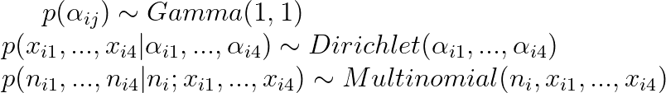
Dirichlet-Multinomial Model
Races: Asian/Pacific Islander, Black, Hispanic, White
Marital Status: Divorced, Married, Single, Widowed
For county i, i from 1 to 10

Slide 22

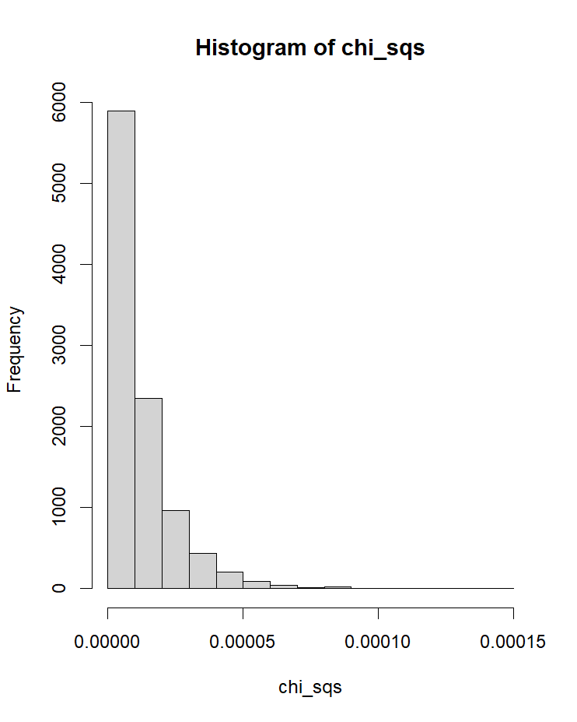
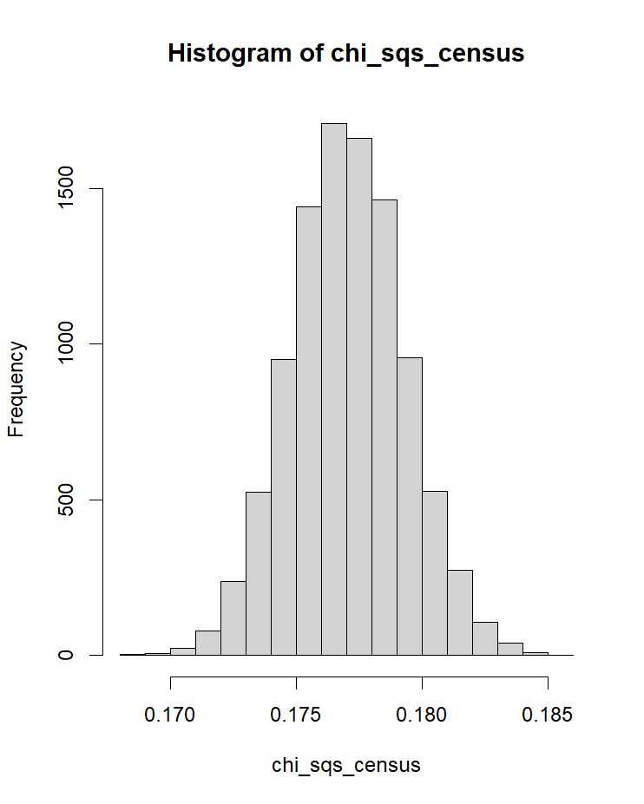
Posterior Sampling Statistic
Given two pdfs,

Slide 23
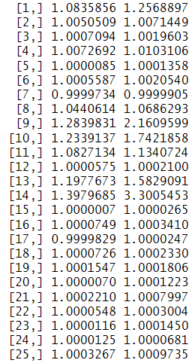
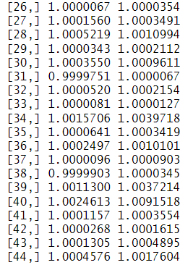
Race: Convergence
20k iterations with 10k burnin
Imperfect convergence when Asian or Black arrests are 0

Slide 24
Race: Posterior Distribution
 | Asian/Pacific Islander | Black | Hispanic | White
Champaign | 1.247% | 58.37% | 5.930% | 34.45%
Cook | 1.284% | 79.22% | 5.603% | 13.89%
Vermillion | 0.235% | 39.41% | 2.263% | 58.10%
Douglas | 0.038% | 7.678% | 4.406% | 87.88%
Ford | 0.076% | 4.100% | 5.653% | 90.17%
New County | 2.885% | 29.20% | 11.73% | 56.19%
Alpha | 0.1328 | 1.246 | 0.500 | 2.368

Slide 25
Race: Census Distribution [2012, 2018 avg]
 | Asian/Pacific Islander | Black | Hispanic | White
Champaign | 10.64% | 13.27% | 5.91% | 70.18%
Cook | 7.31% | 23.97% | 25.19% | 43.52%
Vermillion | 0.82% | 13.50% | 4.96% | 80.71%
Douglas | 0.56% | 0.40% | 6.98% | 92.05%
Ford | 0.41% | 0.81% | 2.99% | 95.79%

Slide 26
Race: Difference [Relative]
 | Asian/Pacific Islander | Black | Hispanic | White
Champaign | 0.12 | 4.40 | 1.00 | 0.49
Cook | 0.18 | 3.30 | 0.22 | 0.32
Vermillion | 0.29 | 2.92 | 0.46 | 0.72
Douglas | 0.07 | 18.96 | 0.63 | 0.95
Ford | 0.19 | 5.06 | 1.89 | 0.94

Slide 27
Race: p-value
 | Asian/Pacific Islander | Black | Hispanic | White
Champaign | 0 | 0 | 0 | 0
Cook | 0 | 0 | 0 | 0
Vermillion | 0 | 0 | 0 | 0
Douglas | 0 | 0 | 0 | 0
Ford | 0 | 0 | 0 | 0

Slide 28
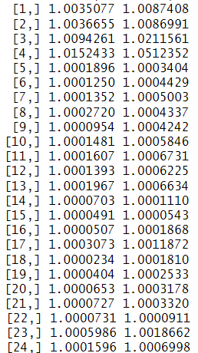
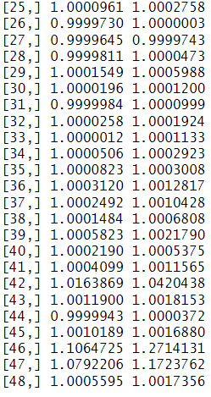
Marital: Convergence
20k iterations with 10k burnin

Slide 29
Marital: Posterior Distribution
 | Divorced | Married | Single | Widowed
Champaign | 10.40% | 11.83% | 77.08% | 0.68%
Cook | 3.51% | 6.06% | 89.60% | 0.83%
Vermillion | 18.05% | 13.47% | 68.34% | 0.14%
McLean | 8.79% | 8.83% | 81.87% | 0.52%
Macon | 9.16% | 8.77% | 81.97% | 0.09%
New County | 13.70% | 14.65% | 69.19% | 2.46%
Alpha | 1.55 | 1.66 | 7.92 | 0.269

Slide 30
Marital: Census Distribution [2010]
 | Divorced | Married | Single | Widowed
Champaign | 10.00% | 40.00% | 46.00% | 4.00%
Cook | 11.00% | 42.00% | 41.00% | 6.00%
Vermillion | 17.00% | 46.00% | 29.00% | 8.00%
McLean | 10.00% | 48.00% | 37.50% | 4.50%
Macon | 15.50% | 47.00% | 30.50% | 7.00%

Slide 31
Marital: Difference [Relative]
 | Divorced | Married | Single | Widowed
Champaign | 1.04 | 0.30 | 1.68 | 0.17
Cook | 0.32 | 0.14 | 2.19 | 0.14
Vermillion | 1.06 | 0.29 | 2.36 | 0.02
McLean | 0.88 | 0.18 | 2.18 | 0.12
Macon | 0.59 | 0.19 | 2.69 | 0.01

Slide 32
Marital: p-value
 | Divorced | Married | Single | Widowed
Champaign | 0 | 0 | 0 | 0
Cook | 0 | 0 | 0 | 0
Vermillion | 0 | 0 | 0 | 0
McLean | 0 | 0 | 0 | 0
Macon | 0 | 0 | 0 | 0

Slide 33
Normal Variables

Slide 34
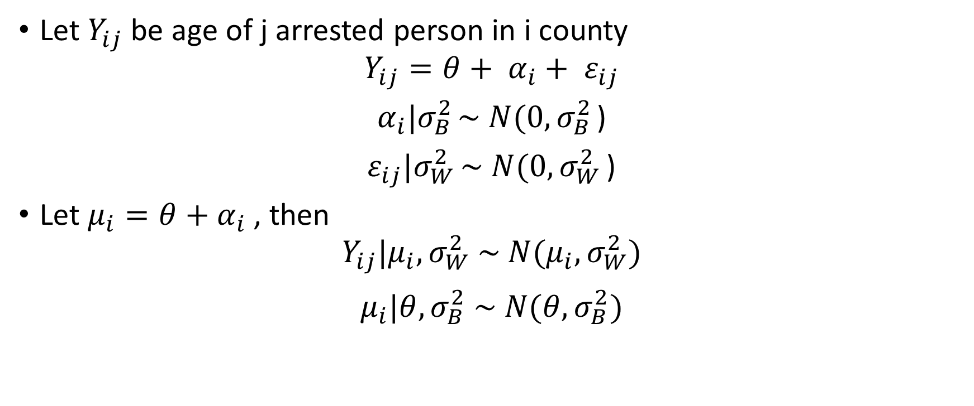
Age Distribution Model

Slide 35
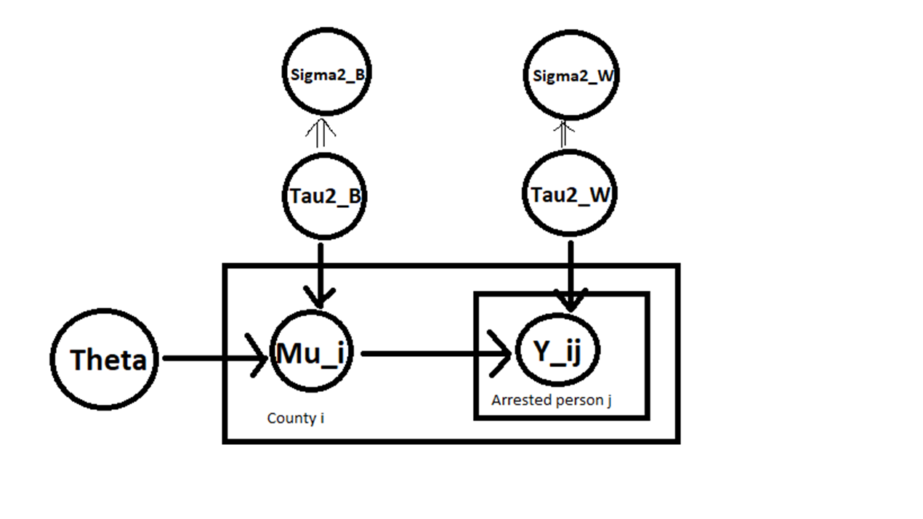
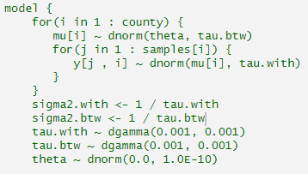
Acyclic Graph & Prior

Slide 36
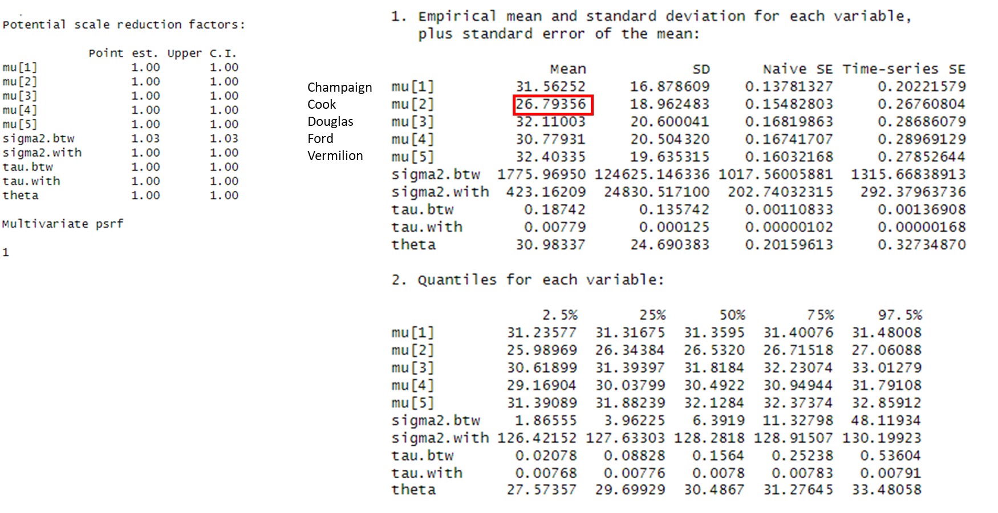
Convergence & Posterior Distribution

Slide 37
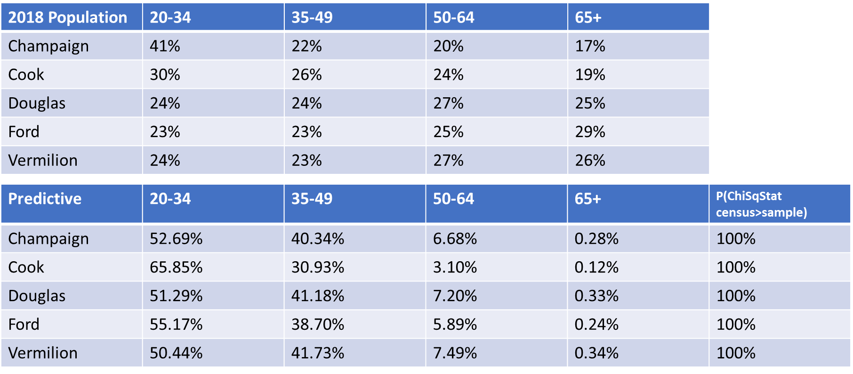
Age Distribution Comparison

Slide 38
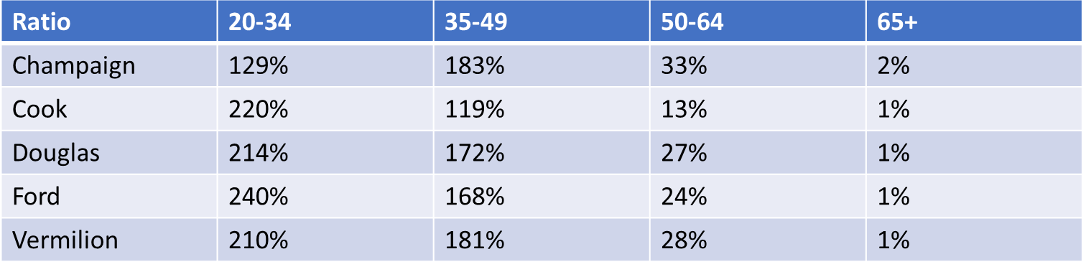
Ratio Posterior Predictive - to - Census

Slide 39
Conclusion
Overrepresented: Younger (20-34), Male, Unemployed, No School, Black, Single
Underrepresented: Older (65+), Female, Employed, Educated, Asian/White, Married/Widowed
Extend to Illinois dataset

